Slide 1


Eric Herendeen
AMIGEN
R & D
August 20, 2021
Amigen HDF5 Internship Project 1
ALL DATA AND INFORMATION CONTAINED OR DISCLOSED BY THIS DOCUMENT IS CONFIDENTIAL AND PROPRIETARY OF AMIGEN, LLC AND ALL RIGHTS THEREIN ARE EXPRESSLY RESERVED. BY ACCEPTING THIS MATERIAL, THE RECEIPIENT AGREES THAT THE MATERIAL AND THE INFORMATION THERIN IS HELD IN CONFIDENCE AND IN TRUST WILL NOT BE COPIED, REPRODUCED IN WHOLE OR IN PART, NOR ITS CONTENTS REVEALED IN ANY MANNER TO OTHERS, EXCEPT TO MEET THE SPECIFIC PURPOSE FOR WHICH IT WAS DELIVERED.

Slide 2
Overview
Amigen needs the capability to save captured frame data from its pipelines
HDF5 was chosen because:
Built around reading/writing large amounts of complex scientific data
Can run both on target and an pc
Pre-existing code and tools
Easy to implement bug fixes and algorithmic development
Good support for data analysis
MATLAB
Python
Labview
Mathematica
ParaView
Used by many organizations
NASA Earth Science Enterprise
International Space Station
The R Project for Statistical Computing
etc.

Slide 3
What is Libamigen?
Libamigen is an API that allows Amigen to develop imaging-related pipelines
Structured in a way that it is easy to implement and add capability to any pipeline
Grow as it needs to
Library that contains the code to produce pipelines
Source - Test video, camera, video file, etc
Sinks - Display, pc-window, video file, etc
Image processing - NUC, histogram equalization, edge enhancement, etc
Hardware abstraction - Video encoding, image composition, camera/display interfaces, etc
What is a Pipeline?
A sequence of components used to create, process, modify, and display image/video data
Manages components, memory, multi-threading, latency, frame rate, and data formats
What are Components?
Processing stages in a pipeline that perform a dedicated function
i.e. TestVideoSource - creates random frame data and pushes it down the pipeline
Contains features/properties to control behavior
Contains a combination of InPorts and OutPorts
What are Ports?
Ports are the connections between components
Data is passed from one port to another
Data is produced by a source, flows through ports to components, and is consumed by sinks

Slide 4
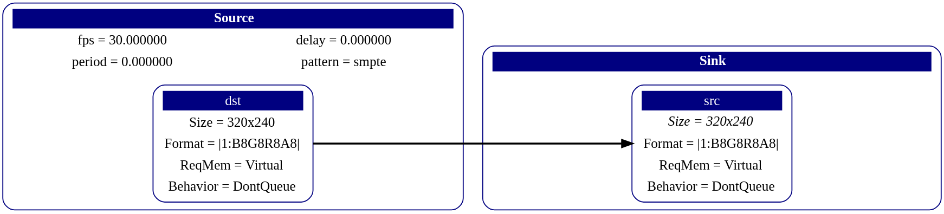

Pipeline Example
Component
Features
Port
Direction of data

Slide 5
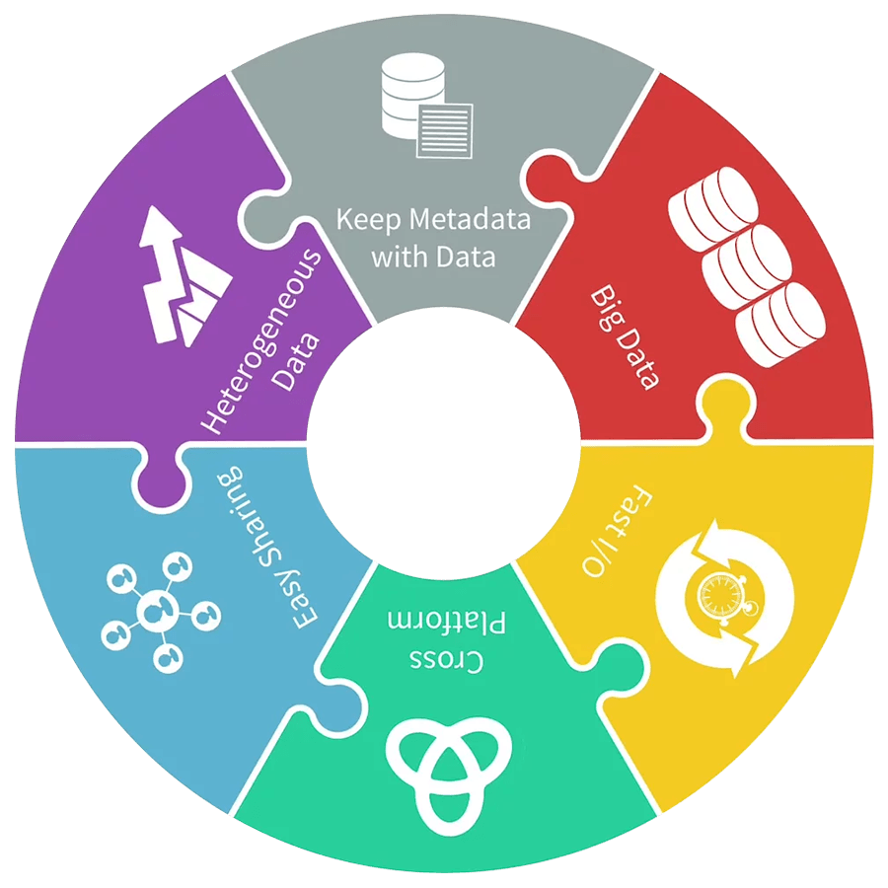
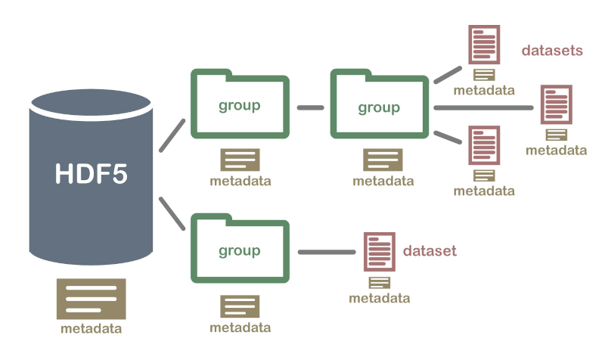
What is HDF5?
HDF5 is a hierarchical file format that supports the creation and management of large scientific heterogeneous data
HDF5 supports n-dimensional datasets and each element in the dataset may itself be a user designed complex object
HDF5 is a self-describing file format, meaning all data and metadata can be passed along in one file
HDF5 is a software library that runs on a range of computational platforms, of which we will be using the C interface
HDF Groups C++ API is lacking, however a 3rd party API called HighFive is used for C++ support
HDF5 is capable of high-performance I/O with a set of integrated performance features that allow for access time and storage space optimizations
Image: Hierarchical Data Format (HDF5) (From https://www.hdfgroup.org/)
Image: Hierarchical Data Format (HDF5) Dataset (From https://www.neonscience.org/about-hdf5)

Slide 6
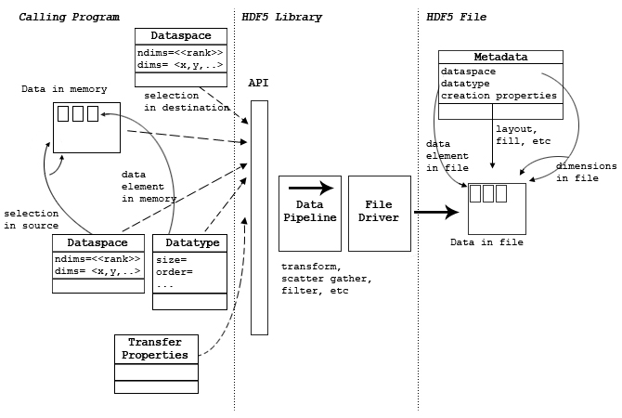
HDF5 Goals
Capability to run on target(products) and on host pc devices
Capability to capture and save data (low-light, thermal data, etc.), either individually or from multiple sources at once on a single component
Capable of I/O fast enough to not bog down the pipeline on target or on host
Data structured to be exportable and viewable with the use of in house and HDF provided tooling
Capable of replaying the exact data into a new pipeline, where it can be changed or run as is from a single component
Behavior can be changed by the user
Image: Dsets_fig5 (From https://support.hdfgroup.org/HDF5/doc1.6/UG/10_Datasets.html)

Slide 7
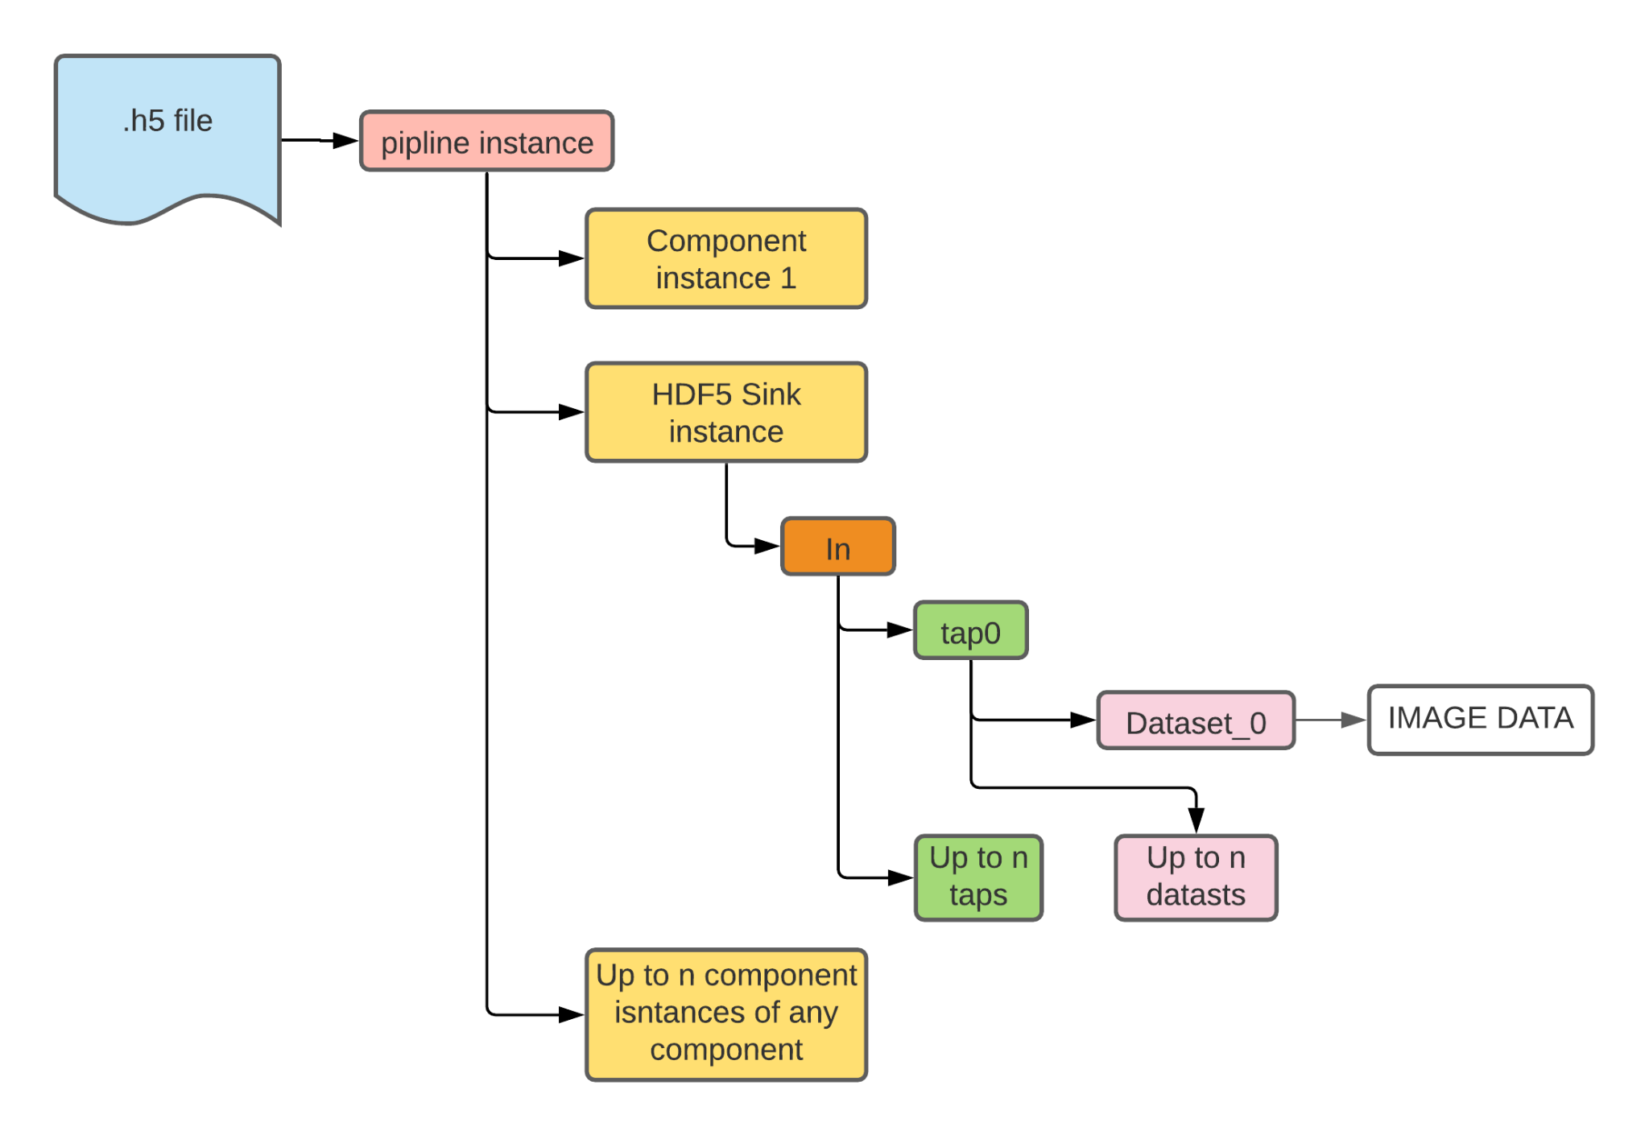
Libamigen HDF5 File Structure

Slide 8
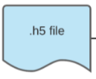
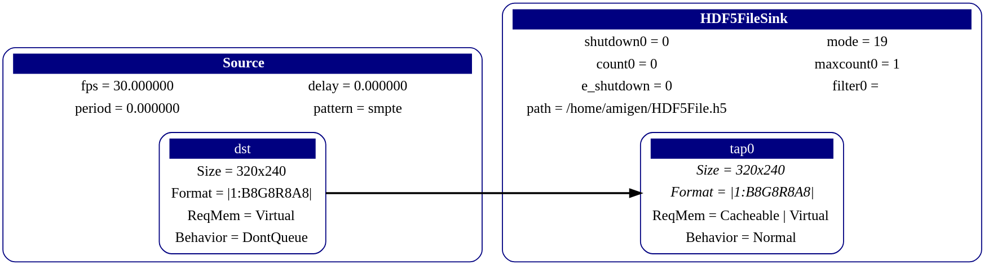
HDF5 Support: Sinks
Summary:
Source component sends frame data from OutPort ‘dst’ to a HDF5FileSink component
HDF5FileSink writes frame data to a .h5 file

Slide 9
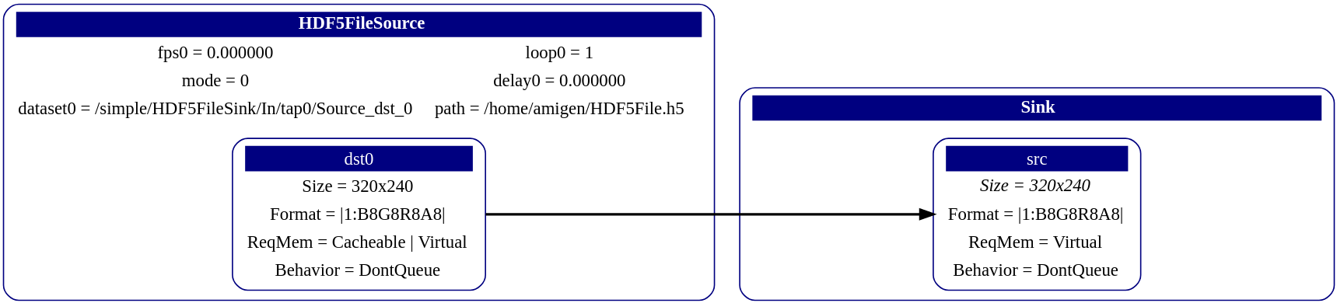
HDF5 Support: Sources
Summary:
HDF5FileSource reads frame data from a .h5 file, then sends frame data from OutPort ‘dst0’ to a Sink component

Slide 10
HDF5 Support: Loads
Reconstructs a new pipeline from a .h5 file
Reads every ‘group’ in the file and determines what it is
Pipeline, component, port
Searches for connections between components and links them together
Supports ‘frame_size’ and ‘frame_format’ features
B8G8R8A8 currently supported
Useful when wanting to replay a pipeline as it was run initially for bug fixing
Pipeline.Load

Slide 11
Component::HDF5FileSink<N>
HDF5FileSink<N> is an Amigen::Component
HDF5FileSink’s can only have InPorts
HDF5FileSink’s InPorts are referred to as ‘taps’
HDF5FileSink’s can have any amount of ‘taps’ connected to it
Each ‘tap’ can be controlled by 6 features determining its behavior during pipeline initialization
Implemented to dynamically save the pipeline structure and any frame data from all of its ‘taps’, directly to an .h5 file
First saves the pipeline structure, iterating over registered/valid components and connected subcomponents
Saves metadata as attributes for all components and subcomponents during this process
Then appends frame data to an extensible 4D dataset inside a uniquely named group
Dataset dimensions are of (Time * Frame Height * Frame Width * Pixel Component)
Saves all libamigen supported formats
Can save frame data infinitely or to a max amount set by features
Storage safe!
Detects when the directory the its writing to is about to run out of disk space
Safely stops writing w/o corrupting already written data
Features can control additional behavior when these conditions are met
Many feature combinations allow freedom to collect frame data in whatever way is needed

Slide 12
HDF5FileSink<N> Settings and Defaults
Feature Name | Supported Amount | Default Value | Supported Inputs | Description
<std::string> path | 1 | “defaultFile.h5” | any std::string | Contains the path to the .h5 file on disk
<int> count | <N> | 0 | n | Sets the frame count in initialization before Produce( ) has been called. Best if it set to 0.
<int> maxcount | <N> | 0 | 0 : infinitely save data n | Sets the maximum amount of frames of frame data to write. A check is made before the structure is saved to determine if the maxcount of all connected taps exceed the disk space available. Returns Error::Memory if true. If set to 0, tells the component to save that tap infinitely, until the program runs out of space or until the program is shutdown.
<int> shutdown | <N> | 0 | 0 : do not shutdown 1 : shutdown | Determines whether or not to shutdown the entire pipeline when a tap has reached its maxcount. If it is 0, then the tap is deactivated and only taps that have yet to reach their maxcount, or if another tap has its shutdown set to 1. Infinite taps are written regardless if the taps shutdown is 1.
<int> e_shutdown | 1 | 0 | 0 : do not shutdown 1 : shutdown | Determines if the pipeline is shutdown when disk + overhead is out of space. Overhead is set to 10 * 1024^2 (~10MB).
<std::string> filter | <N> | empty std::string “” | “gzip,n” for n = 1 through 9 | Determines the level of Gzip compression (major performance hit). A greater level of compression requires more processing time, which delays the pipeline significantly. Even level 1 is great performance hit.
<unsigned int> mode “file enum” | N/A | ReadWrite, Create Truncate | ReadOnly, ReadWrite, Truncate, Excl, Debug, Create, Truncate, Overwrite, OpenOrCreate | Determines the file behavior when writing/reading a .h5 file. Every option must have “HighFive::File::” proceed it and be cast to an <unsigned int> i.e. (unsigned int) HighFive::File::Overwrite

Slide 13
Component::HDF5FileSource<N>
HDF5FileSource<N> is an Amigen::Component
HDF5FileSource’s can only have OutPorts
OutPorts are referred to as ‘dst’
HDF5FileSource’s can have as many dst connections as there are components
Each ‘dst’ can be controlled by 5 features determining its behavior during pipeline initialization
Implemented to dynamically read data from a dataset to another component in the pipeline
First checks if the given path is a valid path to a valid HDF5 file to a valid dataset
Then reads the attributes from the dst’s OutPort group in the .h5 and sets the incoming and outgoing connections frame size and frame format
Currently supports 3 frame formats:
B8G8R8A8 (RGBA)
Y8U8Y8V8 (YUV)
I8 (Thermal)
Can feed frame data infinitely or once set by features
Component::OpenGLSink has been changed to show multiple windows at the same time
Works well when trying to just view the data from a dataset
Supports any amount, but each OpenGLSink must be declared separately
Many feature combinations allow freedom to show frame data in whatever way is needed

Slide 14
HDF5FileSource<N> Settings and Defaults
Feature Name | Supported Amount | Default Value | Supported Inputs | Description
<std::string> path | 1 | empty std::string | “defaultFile.h5” | Contains the path to the .h5 file on disk. Value is checked during initialization, returns Error::InvalidFileType if bad value.
<float> fps | <N> | 0 | n | Determines how fast frame data is read and pushed down the pipeline. Value is represented in Hz.
<std::string> dataset | <N> | empty std::string | any std::string | Contains the path to the dataset inside the .h5 file. Value is checked during initialization, returns Error::InvalidFileType if bad value.
<int> loop | <N> | 0 | 0 : do not loop 1 : loop | Determines if the component loops back to the beginning the dataset when it reaches the last frame. WIll continue behavior until the output window is closed of the program is shutdown.
<float> delay | <N> | 0 | n | Determines the delay of data playback. Will not start reading and pushing data down the pipeline until delay is passed. Useful for running on hardware.
<unsigned int> mode “file enum” | N/A | ReadOnly | ReadOnly, ReadWrite, Truncate, Excl, Debug, Create, Truncate, Overwrite, OpenOrCreate | Determines the file behavior when writing/reading a .h5 file. Every option must have “HighFive::File::” proceed it and be cast to an <unsigned int> i.e. (unsigned int) HighFive::File::Overwrite

Slide 15
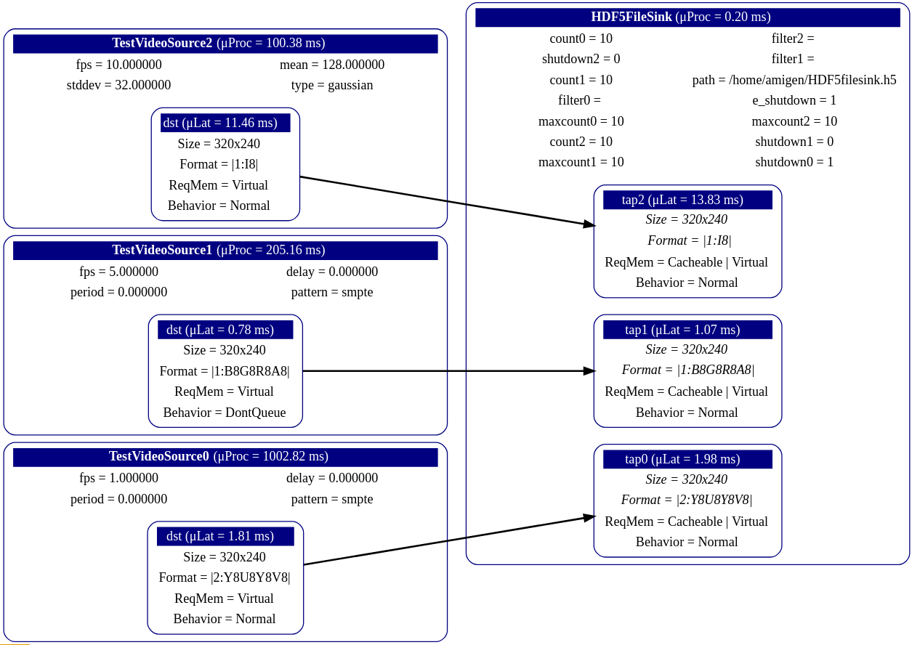
Example Sink Pipeline [Writing]

Slide 16
Tools
HDFView 3.1.2:
HDFView is a visual tool made for browsing and editing HDF5 and HDF4 files
View a libamigen pipeline in a file hierarchy tree structure
View and modify the contents of a dataset
View add, delete and modify attributes
Create and export files
Important!
In its current form, HDFView 3.1.2 only supports 8-bit raster and 24-bit “True-Color” images
Current color spaces supported: RGB, YUV, HSV, CMY, CMYK, YCbCr
Only appears in color when a dataset follows the HDF5 Image and Palette Specification
HDFView does not support 32-bit images or any variation of the above mentioned color spaces
Amigen only uses this tool to verify frame data, as it has its own way to replay/view data
Libamigen tools:
DOT - .dot files are used to create visualizations of libamigen pipelines
CMD line tool - can create and run pipelines from a terminal
In development

Slide 17
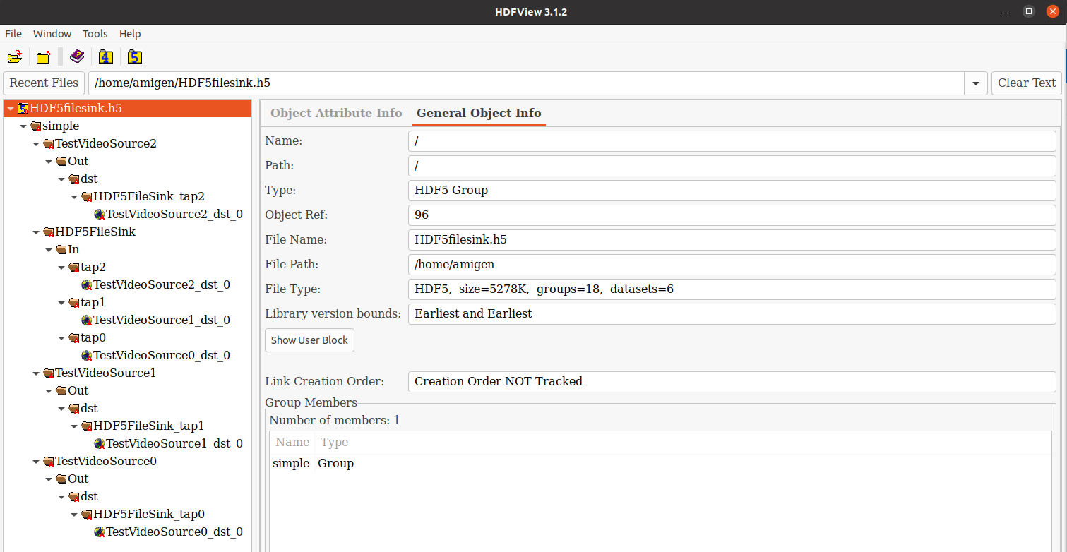
HDFView
Note: Tracking is enabled for every group inside of the “Pipeline” group

Slide 18
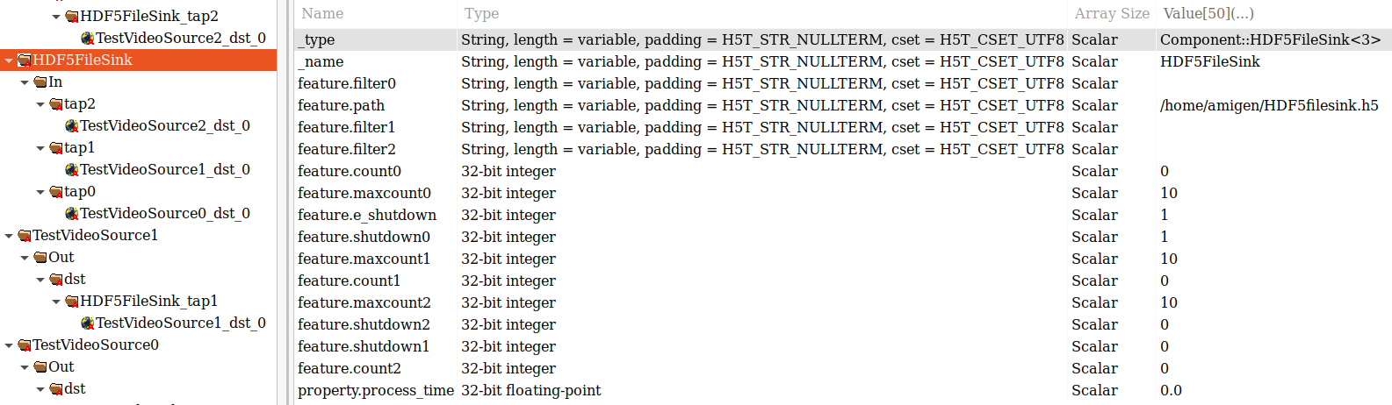
HDFView cont.

Slide 19
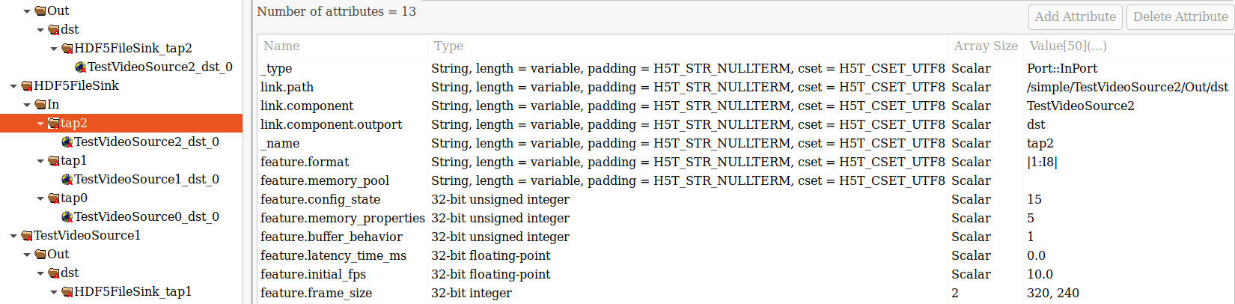
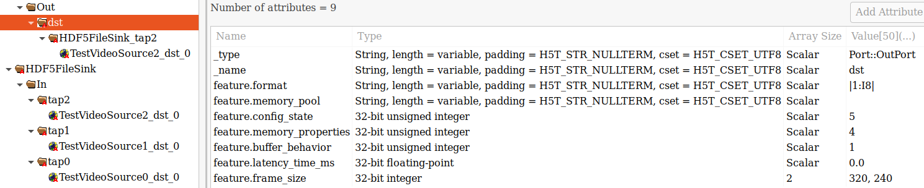
HDFView cont.

Slide 20
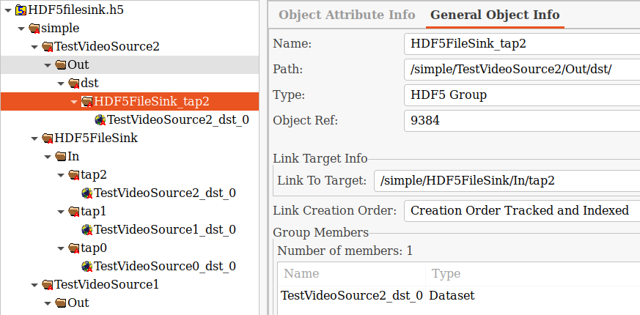
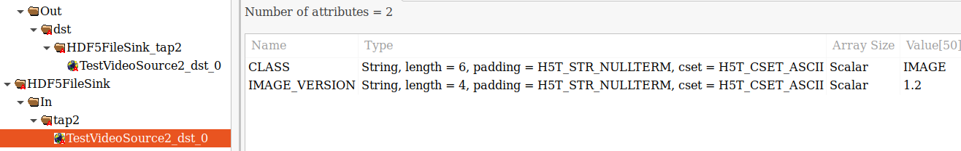
HDFView cont.

Slide 21


Slide 22
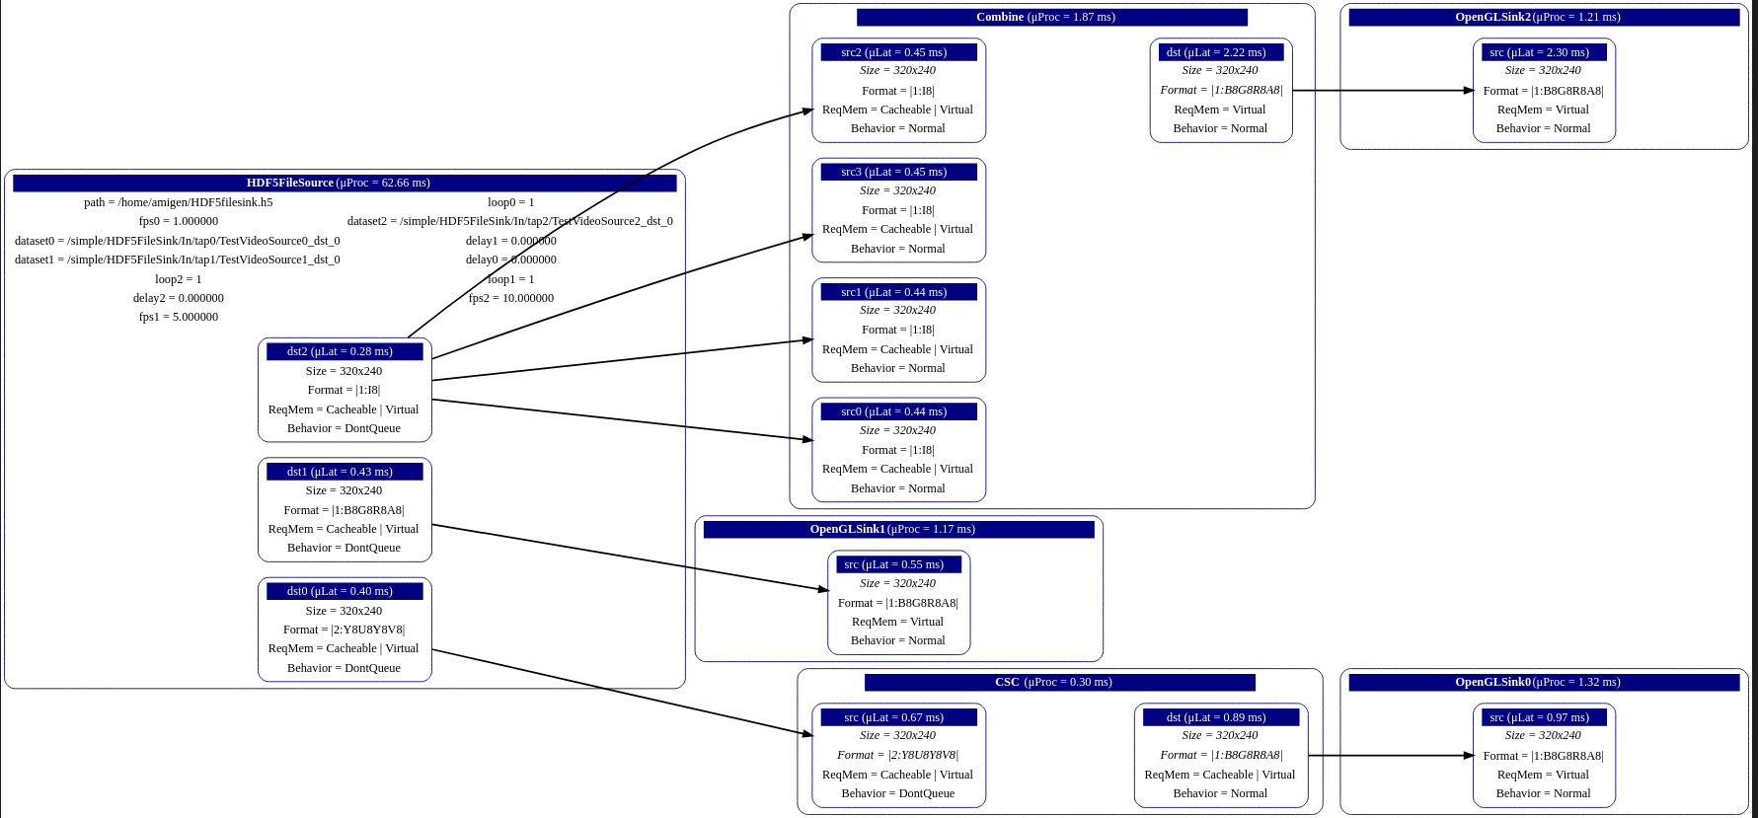
Example Source Pipeline [Reading]

Slide 24
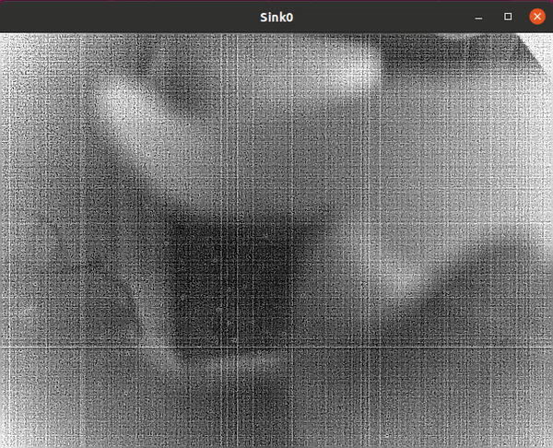
Practical

Slide 25
Engineering Work
Completed over a span of ~10 weeks
Written entirely from C++14
~2000 lines of new code
HDF5 1.8.0 C API’s
HighFive C++ API’s
Introduced new capability to HighFive

